Slide 1
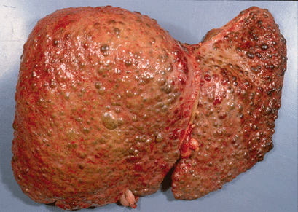
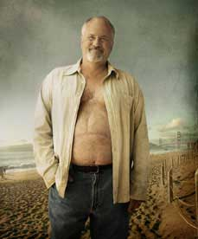
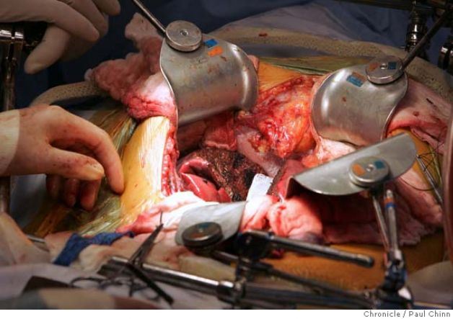
Liver Transplantation - for whom, when & how?
Prof Madunil A Niriella
Professor in Gastroenterology
Honorary Consultant Gastroenterologist & Hepatologist
Colombo North Liver Transplantation Service (CNLTS), Ragama

Slide 2
What is organ transplantation?
Replacement of a diseased organ with a healthy organ
from a donor
with a compatible tissue type
Organs may be
donated by living donors (LD)
harvested from brain-dead (deceased) organ donors (DD)

Slide 3
Indications for liver transplant
Liver has the capacity to regenerate
In the setting of liver injury (e.g. hepatitis or toxin)
after hepatectomy (e.g. Partial liver resection for tumour)
However - liver failure may occur
due to sudden & severe liver injury
-> Acute Liver Failure (ALF)
sustained liver injury
-> Chronic liver disease (End Stage Liver Disease - ESLD)

Slide 4
Indications for liver transplant
Liver Transplantation (LT) is the standard of care for
Liver failure
Acute (ALF)
Chronic (ESLD)
Hepatocellular carcinoma
Early tumours
Fit patients
‘Milano criteria’

Slide 5
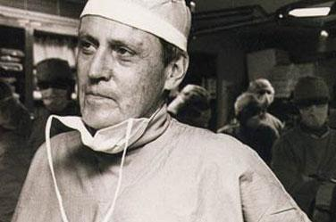
First successful liver transplant
In 1967, by Dr. Thomas Starzl, University of Colorado, USA
The liver functions for thirteen months
Early transplants
1 year survival <25%
Modern liver transplant
Improved survival *
1 year survival – 87%
5 year survival – 73%
* United Network for Organ Sharing (UNOS)

Slide 6
What are the types of LT?
Deceased Donor LT (DDLT)
Brain dead donor
Procurement occurs while prior to cardiac death
Non-heart beating donor
Procurement occurs after cardiac death declared
Live Donor LT (LDLT)
Healthy living donor undergoes partial hepatectomy
Left lobe → for child
Right lobe → for adult

Slide 7
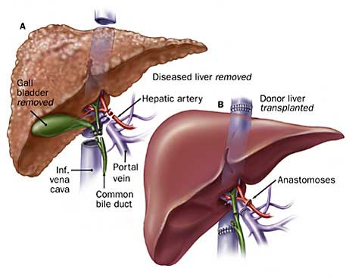
Figure 1. Anatomy of DDLT (Deceased donor liver transplant)

Slide 8
Who will benefit from LT?
Patients with -
Survival after transplant is greater than, survival without transplant (while on waiting list)

Slide 9
How to predict LT benefit?
There are scoring systems to estimate how long cirrhosis patients may survive without transplant
CTP (Child-Turcotte-Pugh) score
Based on 5 elements (Ascites, HE, S.Bil, S.Alb, INR)
Some elements subjective
Inadequate guide
MELD (Model for End-Stage Liver Disease) score
Objective prognostic tool
Most widely used to predict short-term prognosis

Slide 10
MELD
A mathematical calculation, using clinical parameters altered in ESLD
MELD = (0.957 * ln (serum creatinine) + 0.378 * ln (serum bilirubin) + 1.120 * ln (International Normalized Ratio) + 0.643) * 10
Since 2002 organ allocation was based on this score
If the MELD score is ≥ 15
Indicates that the 1-year survival after transplantation exceeds, 1-year survival without (while on the waiting list)

Slide 11
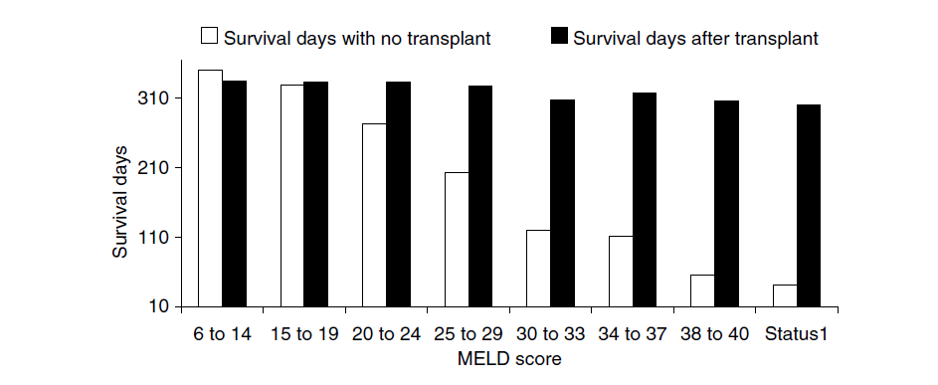
MELD & survival
As the MELD score increases the survival days without transplant markedly decrease, compared to the survival with transplantation
Figure 2. Comparison of average number of days alive for MELD score ranges

Slide 12
When to refer for LT evaluation?
Acute Liver failure (ALF)
Coagulopathy (INR > 1.5) and HE (alteration of level of consciousness)
For Urgent LT
Cirrhosis (ESLD)
MELD > 10; CTP ≥ 7/15
Any decompensation
With complications
UGI bleed, Hepatic encephalopathy
With poor prognosis
Spontaneous Bacterial Peritonitis, Hepato-Renal Syndrome or HCC

Slide 13
Liver Transplantation for HCC: ‘Milano Criteria’
Single tumour, not > 5 cm
Up to 3 tumours, none > 3 cm
+
Absence of macroscopic vascular invasion and
absence of extrahepatic spread on imaging
5-yr survival with transplantation: ~ 70%
5-yr recurrent rates: < 15%
Mazzaferro V, et al. N Engl J Med. 1996;334:693-699. Llovet JM. J Gastroenterol Hepatol. 2002;17(suppl 3):S428-S433.
Notes:
HCC, hepatocellular carcinoma.
Josep M. Llovet, MD:
For patients with liver dysfunction, such as portal hypertension or abnormal bilirubin or those with Child-Pugh class B disease, the first-line treatment option is liver transplantation. When used appropriately, transplantation has been associated with 5-year survival rates of 70% and a 5-year recurrence rates of < 15%. However, there is a shortage of donors in almost every country worldwide. Were this not the case, liver transplantation could be considered in patients with single tumors not > 5 cm or with up to 3 tumors < 3 cm that are not resectable.

Slide 14
Pre-transplant care

Slide 15
Multi-Disciplinary Team (MDT) management for HCC and LT
Hapatologist
Anaesthetist
Oncologist
Radiologist
Hepatobiliary Surgeon
Pathologist
Notes:
Advanced cirrhosis and those with cirrhotic complication requiring LT and those with HCC should ideally be managed in a multi-disciplinary team setting which should include … … for best possible patient outcomes

Slide 16
Liver Transplant MDT
All decisions related to liver transplantation taken by a Multi-Disciplinary Team (MDT)
Team
Hepatologists, Transplant Surgeons, Anaesthetists
Decisions
Recipient - Acceptance for LT
Living Donor – Suitability for donation

Slide 17
Evaluation of recipient for LT
Select patients who will benefit most from LT
Underlying liver disease
Natural history / recurrence
Exclude contraindications
Absolute and relative
Fitness for surgery
Withstand the stress of peri-operative period
Psycho-social circumstances
Long term commitment to follow-up, finances

Slide 18
Contraindications for LT
Absolute
Severe infection and most metastatic cancers
Advanced and non-correctable cardiopulmonary disease
Diffuse intra-abdominal thrombosis
Relative
Age (>70 years)
Psychosocial issues
Recent drug/alcohol use
HIV infection, especially if not responsive to highly active antiretroviral therapy (HAART) treatment
Moderate cardiac or pulmonary impairment

Slide 19
Deceased Donor Evaluation
Screened for
Liver disease – blood
Infection screen – HBV, HCV, TPHA, HIV
Presence of sepsis or malignancy
Managed to avoid
Hypo/hypertension
Hypoxia
Acidosis
DI

Slide 20
Living Donor Evaluation
Screened for
Liver disease – blood +/- liver biopsy
Abnormal liver anatomy – CTA , MRCP
Infection screen – HBV, HCV, TPHA, HIV, Mantoux
Cardio-pulmonary status
Co-existing disease
Psycho-social issues

Slide 21
Matching process
Compatible ABO blood type
A to A
B to B
AB to AB
O to O, A, B or AB
No HLA matching
Compatible body size
Too small liver – ‘Small for size’ → liver failure
Too large – Difficult closure of abdomen

Slide 22
Post –Transplant care

Slide 23
Why is immunosuppression needed?
Transplanted liver (complete or partial graft) is foreign tissue
Host (recipient) immune system recognises ‘non-self’ antigens
Recognised by the adaptive immune response
‘T cell mediated’
Immunosupression is needed to preserve the transplanted organ by suppression of recipient immune system

Slide 24
Effects of immunosuppresion
Blunted host immune response
Desired effect – Prevent rejection & improve graft survival
Unwanted effect – Suppressed immunity
Prone to infection
Prone to malignancies
Drug adverse effects
Metabolic disease
weight gain, HT, DM, Dyslipidaemia
Atherosclerosis
Renal impairment

Slide 25
Balance risks vs. benefits
Desired Effects
Adequate immunosuppression to prevent graft rejection
Undesired Effects
Infections
Malignancies
Metabolic effects
Renal impairment

Slide 26
Immunosuppresive Drugs
Steroids
Prednisolone, Methyl Predinisolone
Calcineurin inhibitors
Tacrolimus, Cyclosporin
Serolimus, everolimus
Azathioprine, mycophenolate mofetil (MMF)
Basiliximab

Slide 27
Immunosuppression in LT
Early – multiple meds, high doses
Pred + CNI* +/- (MMF/AZA)
Additive effects; minimize AE
Tailored to each patient (consider aetiology, active infections, renal dysfunction and the presence of HCC)
Late – fewer (1) meds, lower doses
Most patients CNI alone (usually Tac)
Exceptions:
Autoimmune hepatitis, PSC, PBC (usually 2 drugs)
Renal dysfunction (MMF/AZA + lower CNI dose)
*CNI = calcineurin inhibitor = CsA or Tac

Slide 28
Causes of Allograft Failure
Primary Non-function
lack of bile production, liver failure and MA
in the presence of a patent PV and HA
Vascular Complications –
Thrombosis of hepatic inflow (PV or HA)
Thrombosis of hepatic outflow (HVs)
Billiary Complications –
Anastomotic vs. non-anastomotic strictures
Donors after Cardiac Death, Living Donors

Slide 29
Causes of Allograft Failure
Rejection
Acute
Chronic
Acute vs. Chronic –
time course
pattern of liver enzyme abnormalities
response to therapy

Slide 30
Allograft Rejection
Antibody Mediated Rejection – hours to days
Acute Rejection (20-40%)
Risk 1st 3 months > 1st year > subsequent years
Chronic Rejection (5-10 %)
a primary RF is prior episodes of Acute Rejection

Slide 31
Acute Rejection
Early - RFs –
Young “healthier” recipients
Older donor
PSC/PBC/AIH
long cold ischemia time
Late (>1 year) acute rejection –
inadequate immunosuppression

Slide 32
Acute Rejection
Steroid responsive
MP (one or two courses)
Steroid unresponsive/resistant
Anti-thymocyte Globulin (ATG)
Muromonab-CD 3 (OKT3)
Alemtuzumab (campath)

Slide 33
Chronic Rejection
Virtually always progressive
Re-transplantation usually necessary

Slide 34
Co-morbidities
Renal Dysfunction (up to 20%)
CNI treatment – dose dependent
Reversible – vasoconstriction of Intra-renal Vessels
Irreversible – tubulointerstitial fibrosis
Add MMF to reduce CNI dose or switch to Sirolimus
Diabetes
RF – steroids, high TAC doses
Treat in a similar manner as non-OLT patients –minimize steroids and lower Tac

Slide 35
Co-morbidities
Dyslipidemia
Effects on Lipids:
CSA, Steroids Sirolimus – greatest effect
TAC – minor effect; MMF/AZA – no effect
Treatment – each with potential for drug interactions/toxicities
Obesity
RF for recurrent (or de novo) NASH
TX – the usual

Slide 36
Malignancies
Skin
100x over general population
Squamous Cell (SCC)> Basal Cell > Melanoma
Annual Dermatology exam, use sunscreen/avoid sun exposure
Minimize immunosuppression if diagnosed
PTLD
2% Adults, 80-90% EBV associated, < 1 year post-OLT
Reduce immunsuppresion; Rituximab if CD20 (+), Chemotherapy if CD20 (-)

Slide 37
Malignancies
Upper aero-digestive tract –
increased in those with RFs – ETOH, Tobacco
Colon cancer –
increased risk in those with preexisting RFs – PSC/UC patients –
Annual colonoscopy with surveillance biopsies

Slide 38
Conclusion
LT is the standard of care for liver failure
Modern LT has improved outcomes
Types are DDLT or LDLT
Outcome without LT is predicted by MELD score
Patients with MELD ≥ 15 benefit from LT
Referred for evaluation when MELD > 10
Recipient and donor evaluated for matching, fitness for surgery and contraindications
Post-transplant care involves management of graft failure, immunosuppression and its complications and co-morbidities

Slide 39
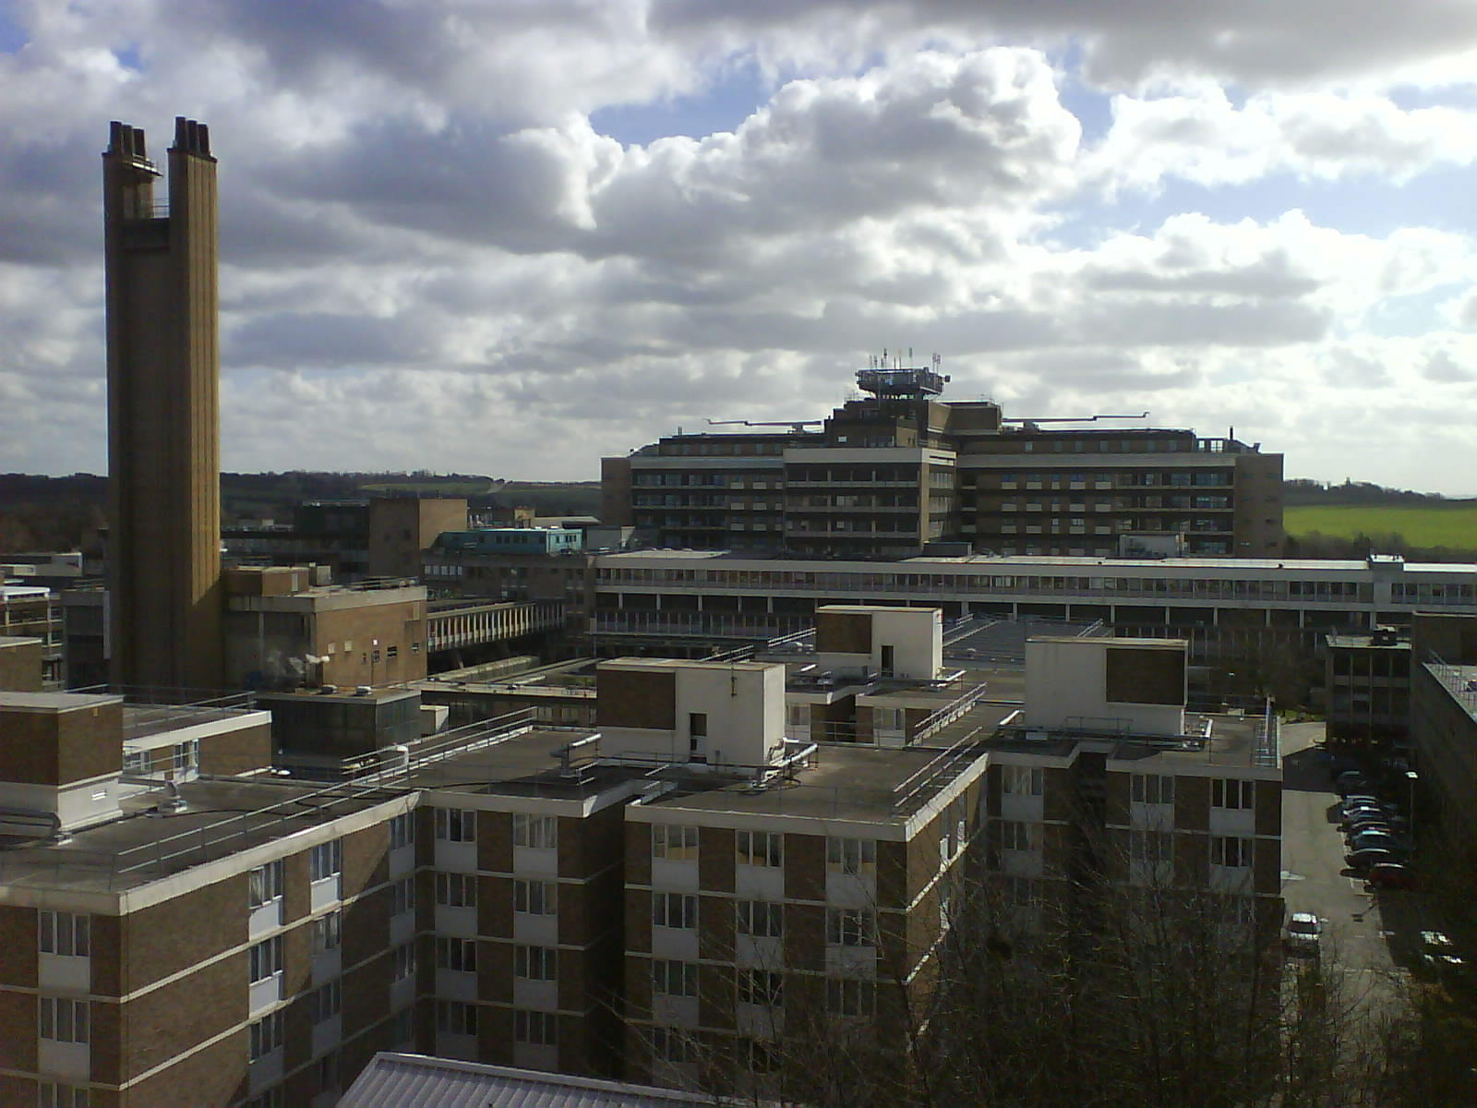
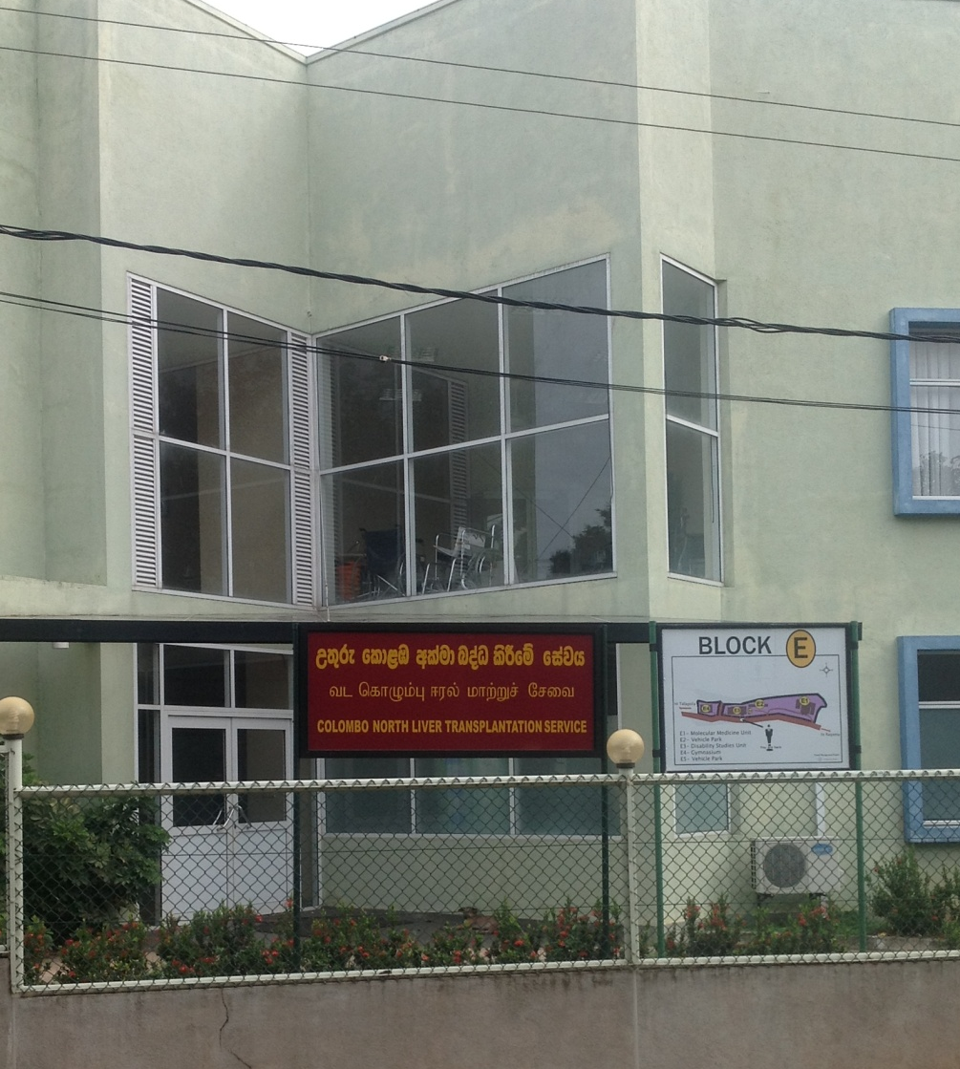
Thank you

